Slide 1
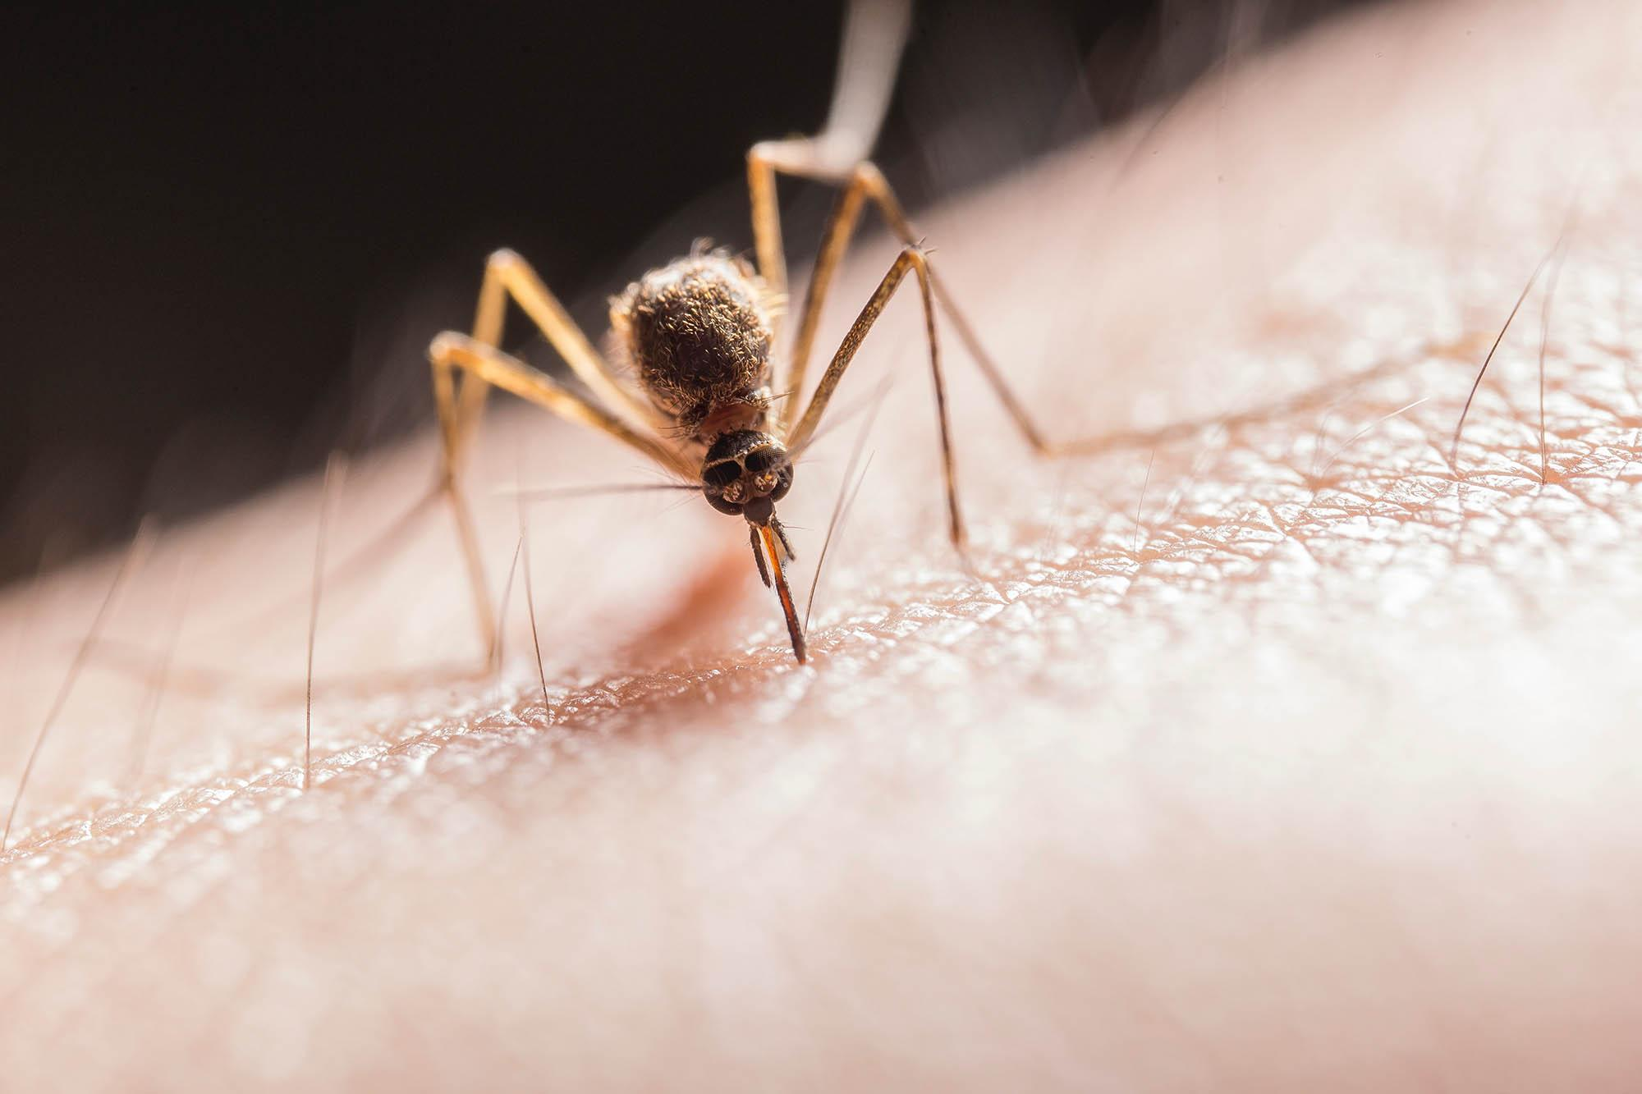
Project 4 West Nile Virus Prediction
By Ethan Koh, Grace Chia, Jocelyn Pok, Randy Neo

Slide 2
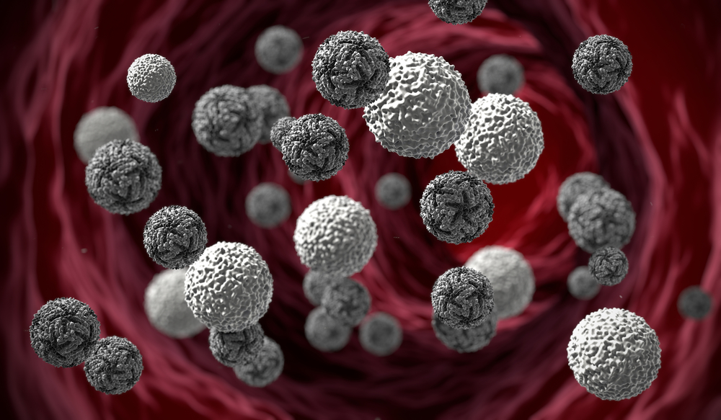
About
West Nile Virus is most commonly spread to humans through infected mosquitos. Around 20% of people who become infected with the virus develop symptoms ranging from a persistent fever, to serious neurological illnesses that can result in death.
In 2002, the first human cases of West Nile virus were reported in Chicago. By 2004 the City of Chicago and the Chicago Department of Public Health (CDPH) had established a comprehensive surveillance and control program that is still in effect today.

Slide 3

Every week from late spring through the fall, mosquitos in traps across the city are tested for the virus. The results of these tests influence when and where the city will spray airborne pesticides to control adult mosquito populations.
Every week from Monday through Wednesday, these traps collect mosquitos, and the mosquitos are tested for the presence of West Nile virus before the end of the week. The test results include the number of mosquitos, the mosquitos species, and whether or not West Nile virus is present in the cohort.

Slide 4

Problem Statement
Due to a recent outbreak of the West Nile Virus in the city of Chicago, the Data Science team at the Disease and Treatment Agency has been tasked by the Centers for Disease Control (CDC) to develop a strategy to deploy the effective use of pesticides. Targeting spraying efforts to areas of high risk will help to mitigate future outbreaks.
Leveraging on weather, location, mosquito population and spraying data, we will build a binary classification model that predicts the presence of the West Nile Virus in the city of Chicago. The model that achieves the highest ROC AUC score on the validation set, will be selected as our production model. The model is also expected to outperform the baseline ROC AUC score of 0.5. A cost-benefit analysis will also be done to determine if the benefits of spraying outweighs its costs.

Slide 5
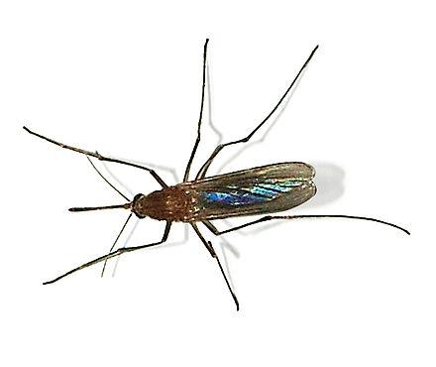
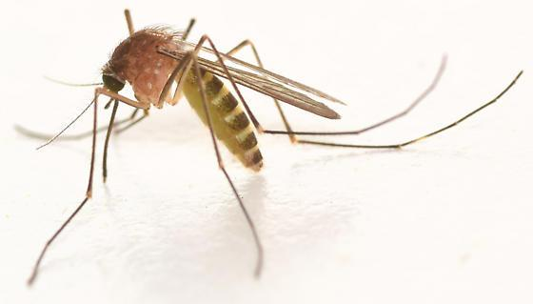
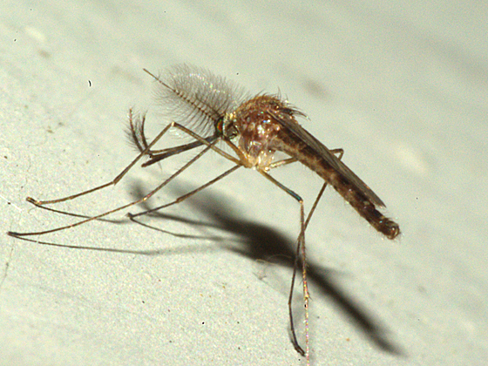
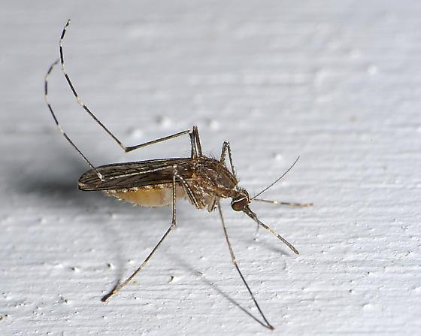
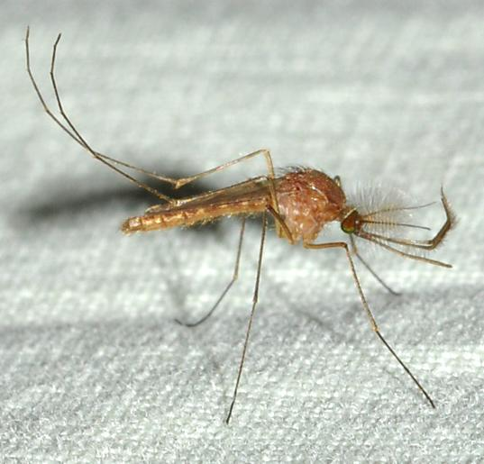
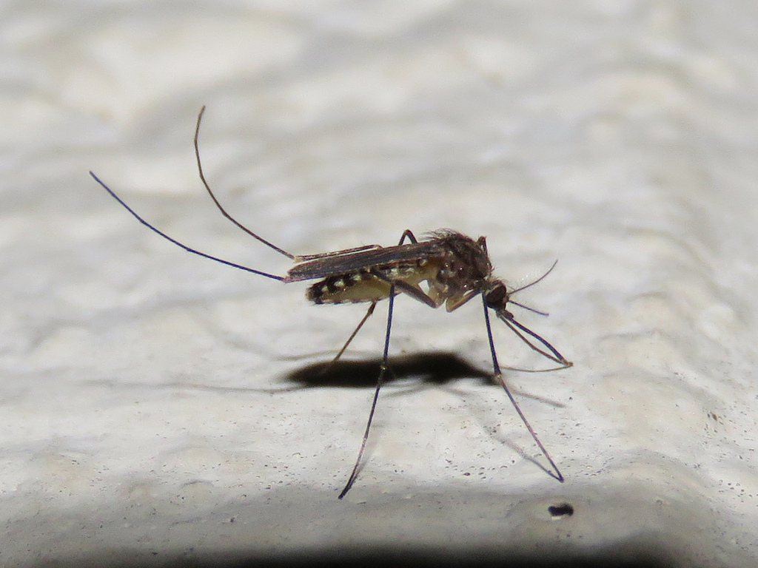
Species of Culex mosquitoes
West Nile virus is primarily transmitted by mosquitoes, mostly species of Culex.
Culex Pipiens
Culex Restuans
Culex Territans
Culex Tarsalis
Culex Salinarius
Culex Erraticus

Slide 6
Data Set Provided
Map Data | The map files mapdata_copyright_openstreetmap_contributors.rds and mapdata_copyright_openstreetmap_contributors.txt are from Open Streetmap and are primarily provided for use in visualizations.
Weather Data | From NOAA of the weather conditions of 2007 to 2014, during the months of the tests. Station 1: CHICAGO O'HARE INTERNATIONAL AIRPORT Lat: 41.995 Lon: -87.933 Elev: 662 ft. above sea level Station 2: CHICAGO MIDWAY INTL ARPT Lat: 41.786 Lon: -87.752 Elev: 612 ft. above sea level. Column descriptions in noaa_weather_qclcd_documentation.pdf.
Spray Data | GIS data of spraying efforts in 2011 and 2013 to reduce the number of mosquitos in the area, and therefore might eliminate the appearance of West Nile virus.
Train and Test data | The training set consists of data from 2007, 2009, 2011, and 2013, while in the test set you are requested to predict the test results for 2008, 2010, 2012, and 2014.

Slide 7
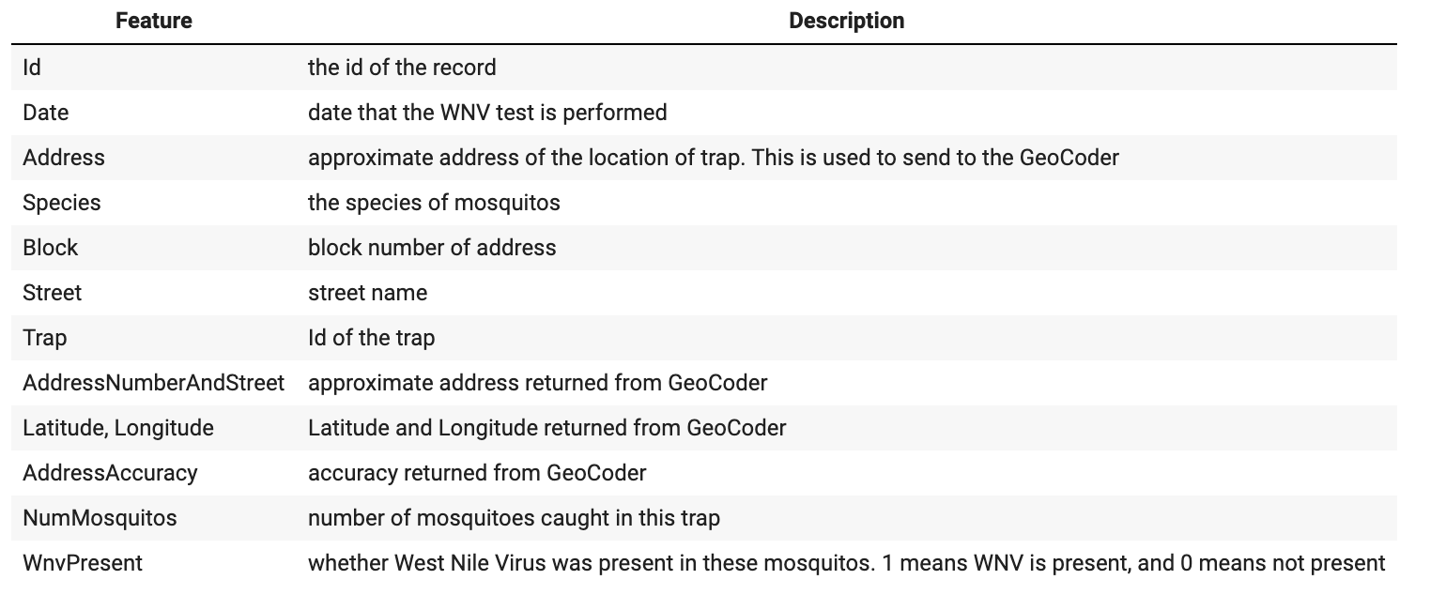
Train Data Set

Slide 8
Data Preparation
1
Data Cleaning + Feature Engineering + EDA

Slide 9
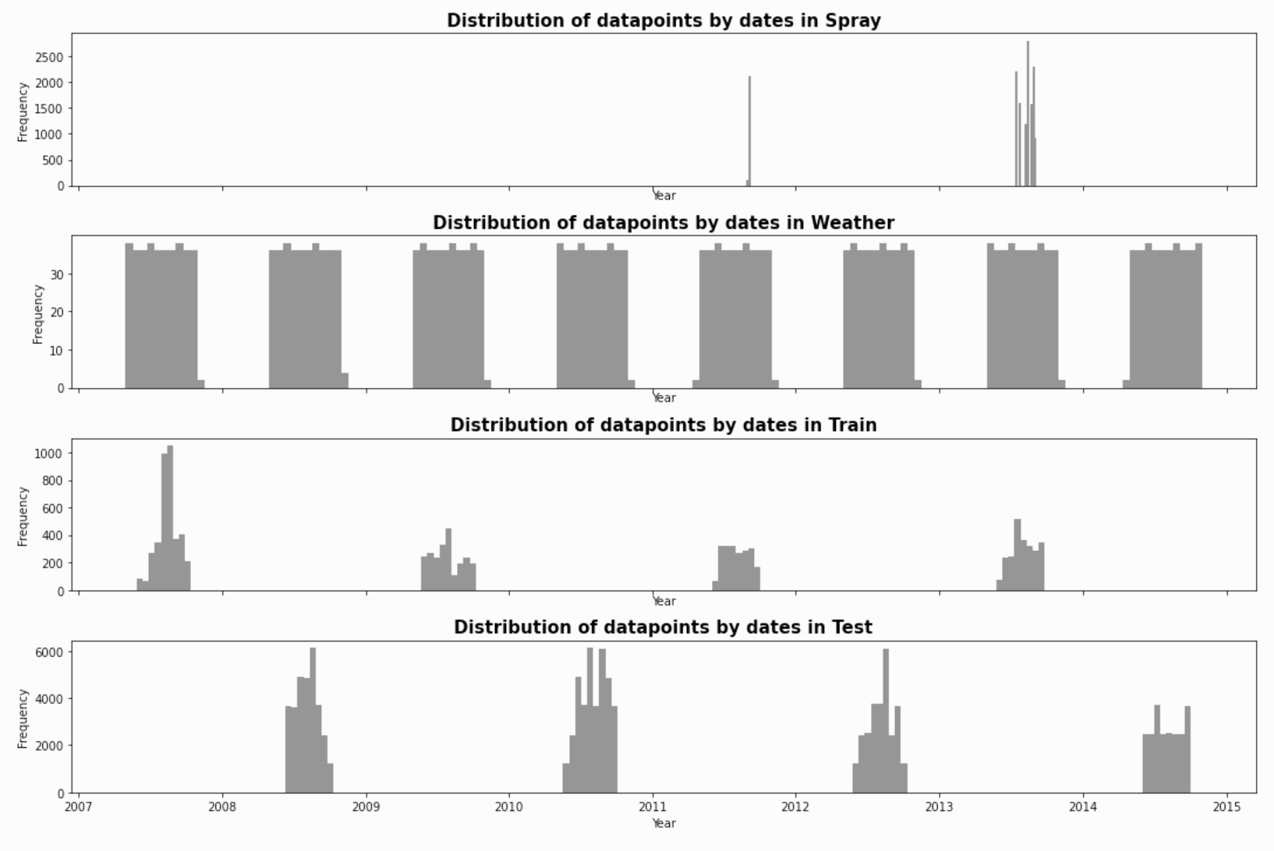
Exploration on provided data set
Spray data is rather limited, with only 10 days of spraying data in 2011 and 2013. There is no indication that this is the complete spray data for each year.
Weather data is provided for the weather conditions of 2007-2014, during the months of the train and test data sets.
Training data set contains the odd-numbered years, 2007, 2009, 2011 and 2013.
On the other hand, the test set for prediction consists of the even-numbered years, 2008, 2010, 2012 and 2014.

Slide 10
DATA CLEANSING & FEATURE ENGINEERING
Weather
Feature Engineering - Train
Null values replacing ('M') and trace values('T).
Non-relevant features dropped (e.g. 'Depth', 'Water1’, 'Snow Fall’, ‘CodeSum’)
object data types cols converted to float & int type.
missing values in Station 1 are imputed from Station 2
Station 2 is dropped as it is further from the WnV hotspot after 2007.
Warm weather conditions in the summer months are more likely to promote WNV. As such, we will breakdown the Date column into more granularity - day, week, month and year. This will help us to identify any effects of seasonality.
Feature Engineering - Spray
Spray clusters are created and visualized where spraying occurred using DBSCAN. Since the spraying occurs in distance based clusters, DBSCAN was selected to perform the unsupervised clustering. DBSCAN uses two parameters, eps (the minimum distance between two points) and minPoints (the minimum number of points to form a dense region). The Spray clusters are subsequently overlayed on locations with WNV presence
Feature Engineering - Weather
Understanding the conditions preferable for mosquito population growth can help us gain insights from the weather condition. Bodies of water are ideal breeding spots for mosquitos, as such the amount of precipitation will be investigated. Features factoring in the frequency of light rain and heavy rain in the last 14 days are generated to analyse the mosquito population when there was rain.

Slide 11
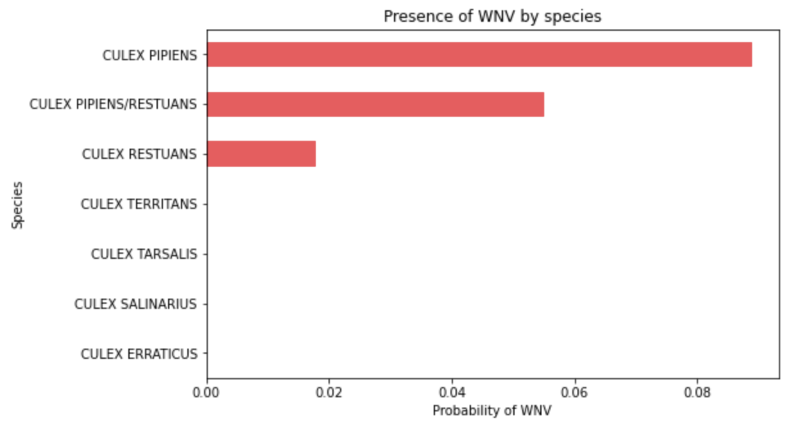
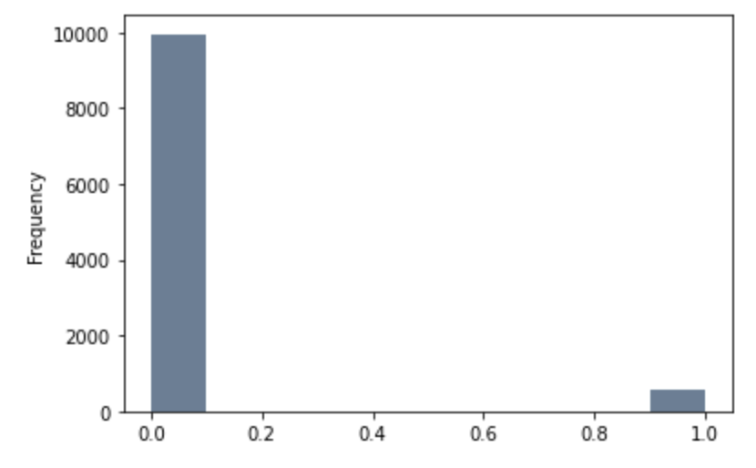
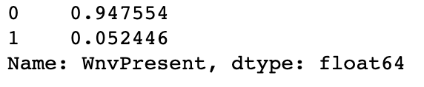
EDA
The dataset is imbalanced with WNV presence accounting for only 5% of dataset.
The prevalence of WNV amongst the species culex pipiens, culex pipiens/restuans and culex restuans is evident.

Slide 12
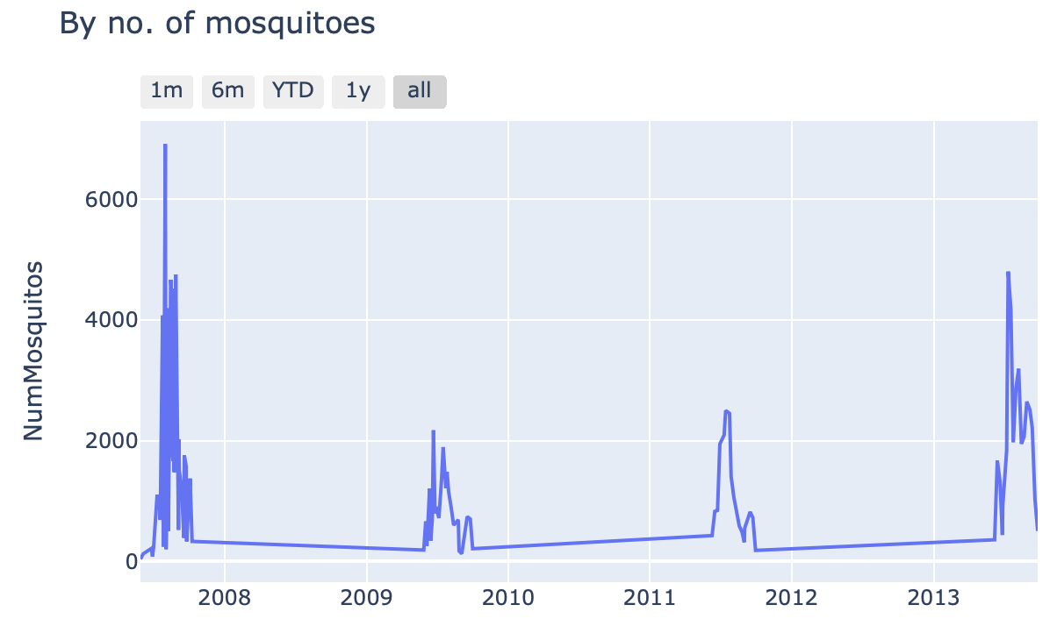
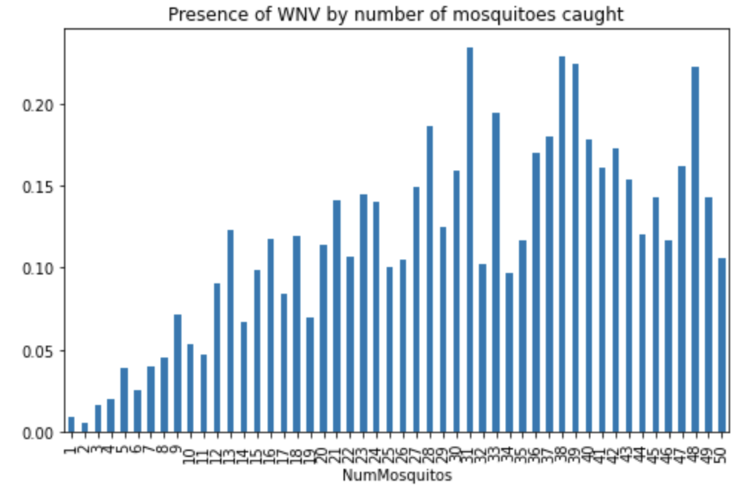
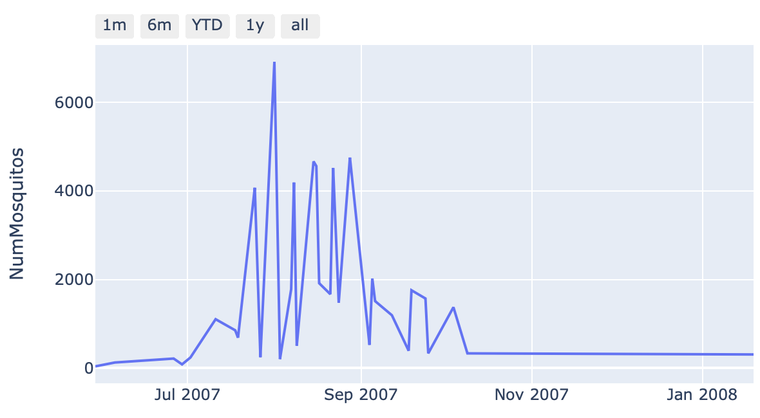
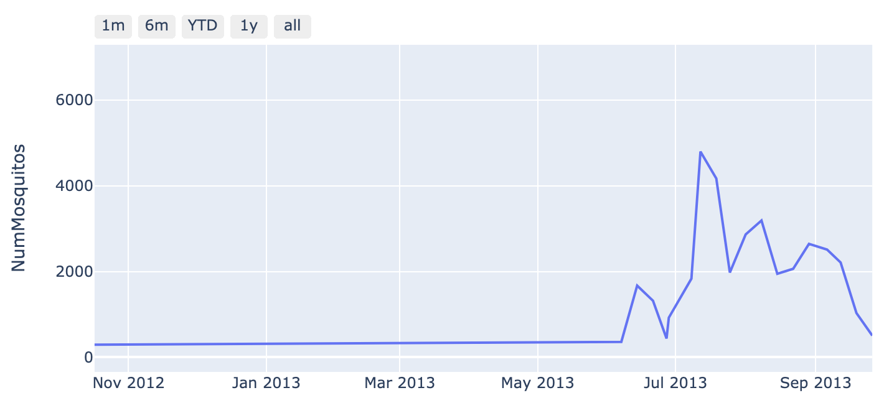
EDA – No. of Mosquitoes vs WnV cases
WNV increases as number of mosquitoes caught increases
The mosquito population is at its peak in the month of August.
WNV increases as number of mosquitoes caught increases

Slide 13
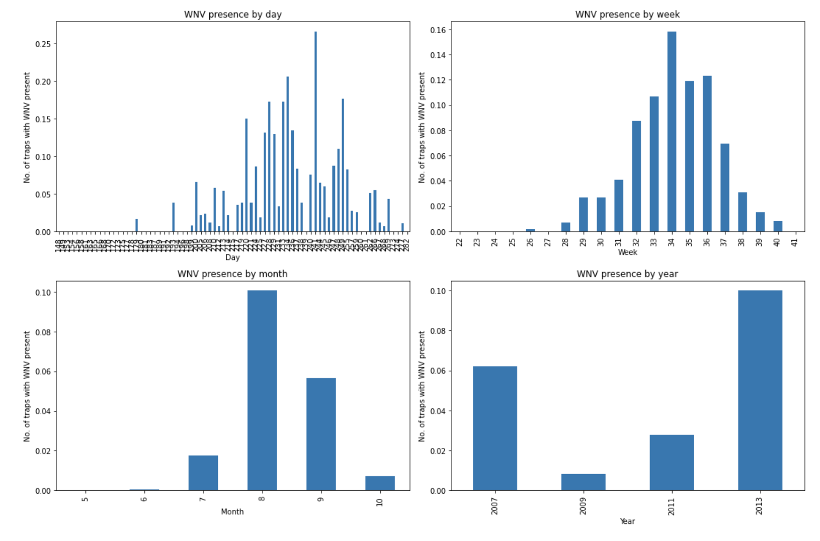
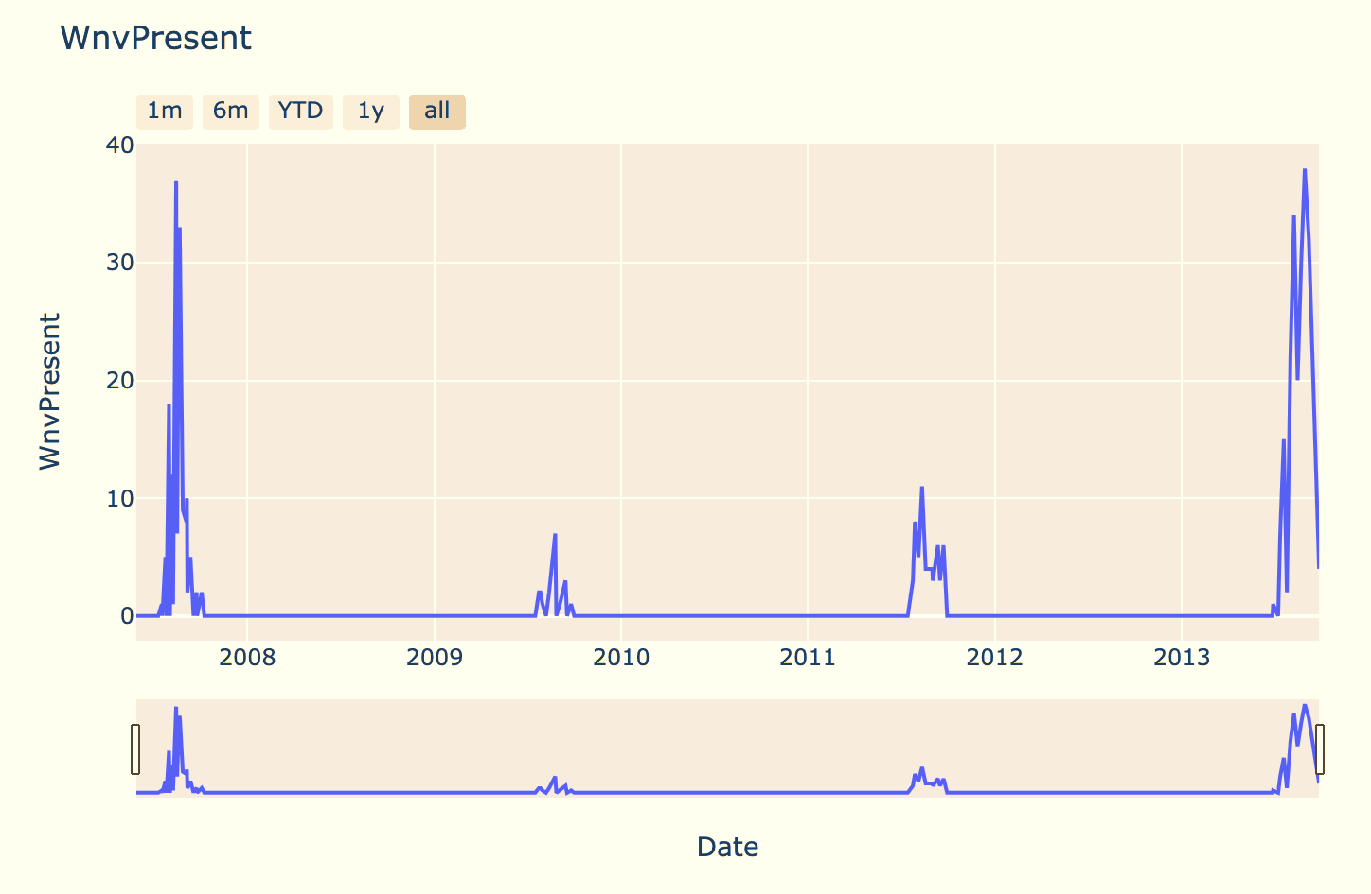
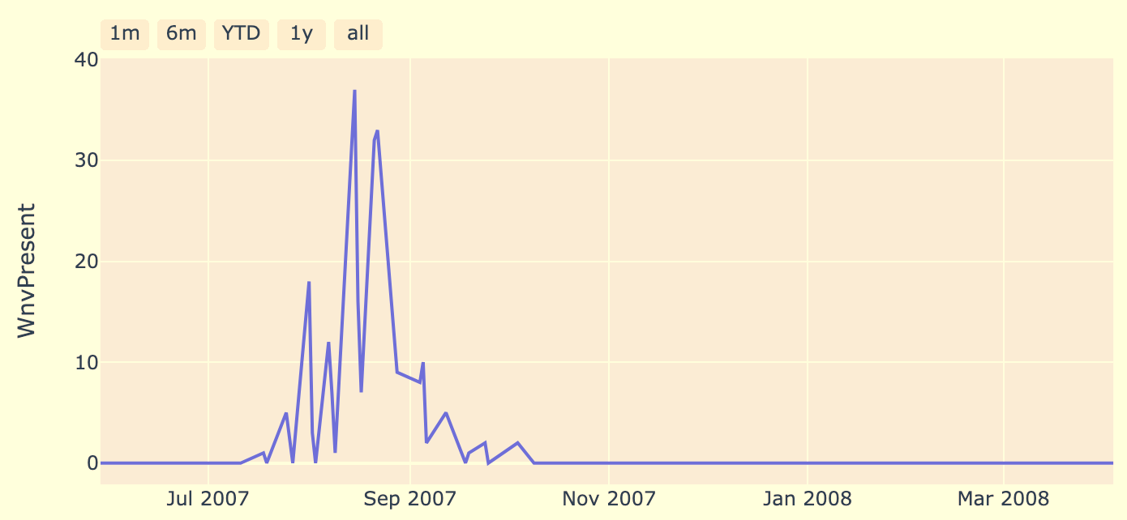
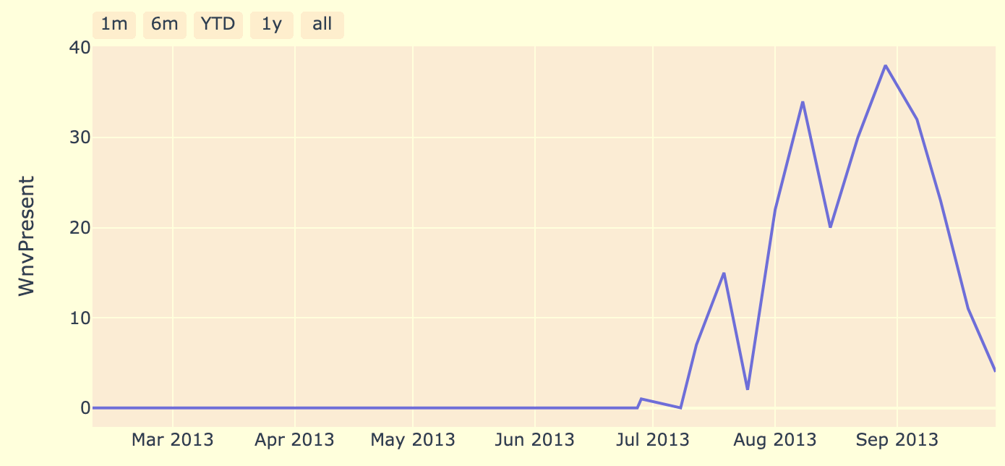
EDA – No. of Mosquitoes vs WnV cases
WNV increases as number of mosquitoes caught increases
Distribution of WNV presence over the years in the train dataset. 2007 & 2013 have higher incidences of WNV presence.

Slide 14
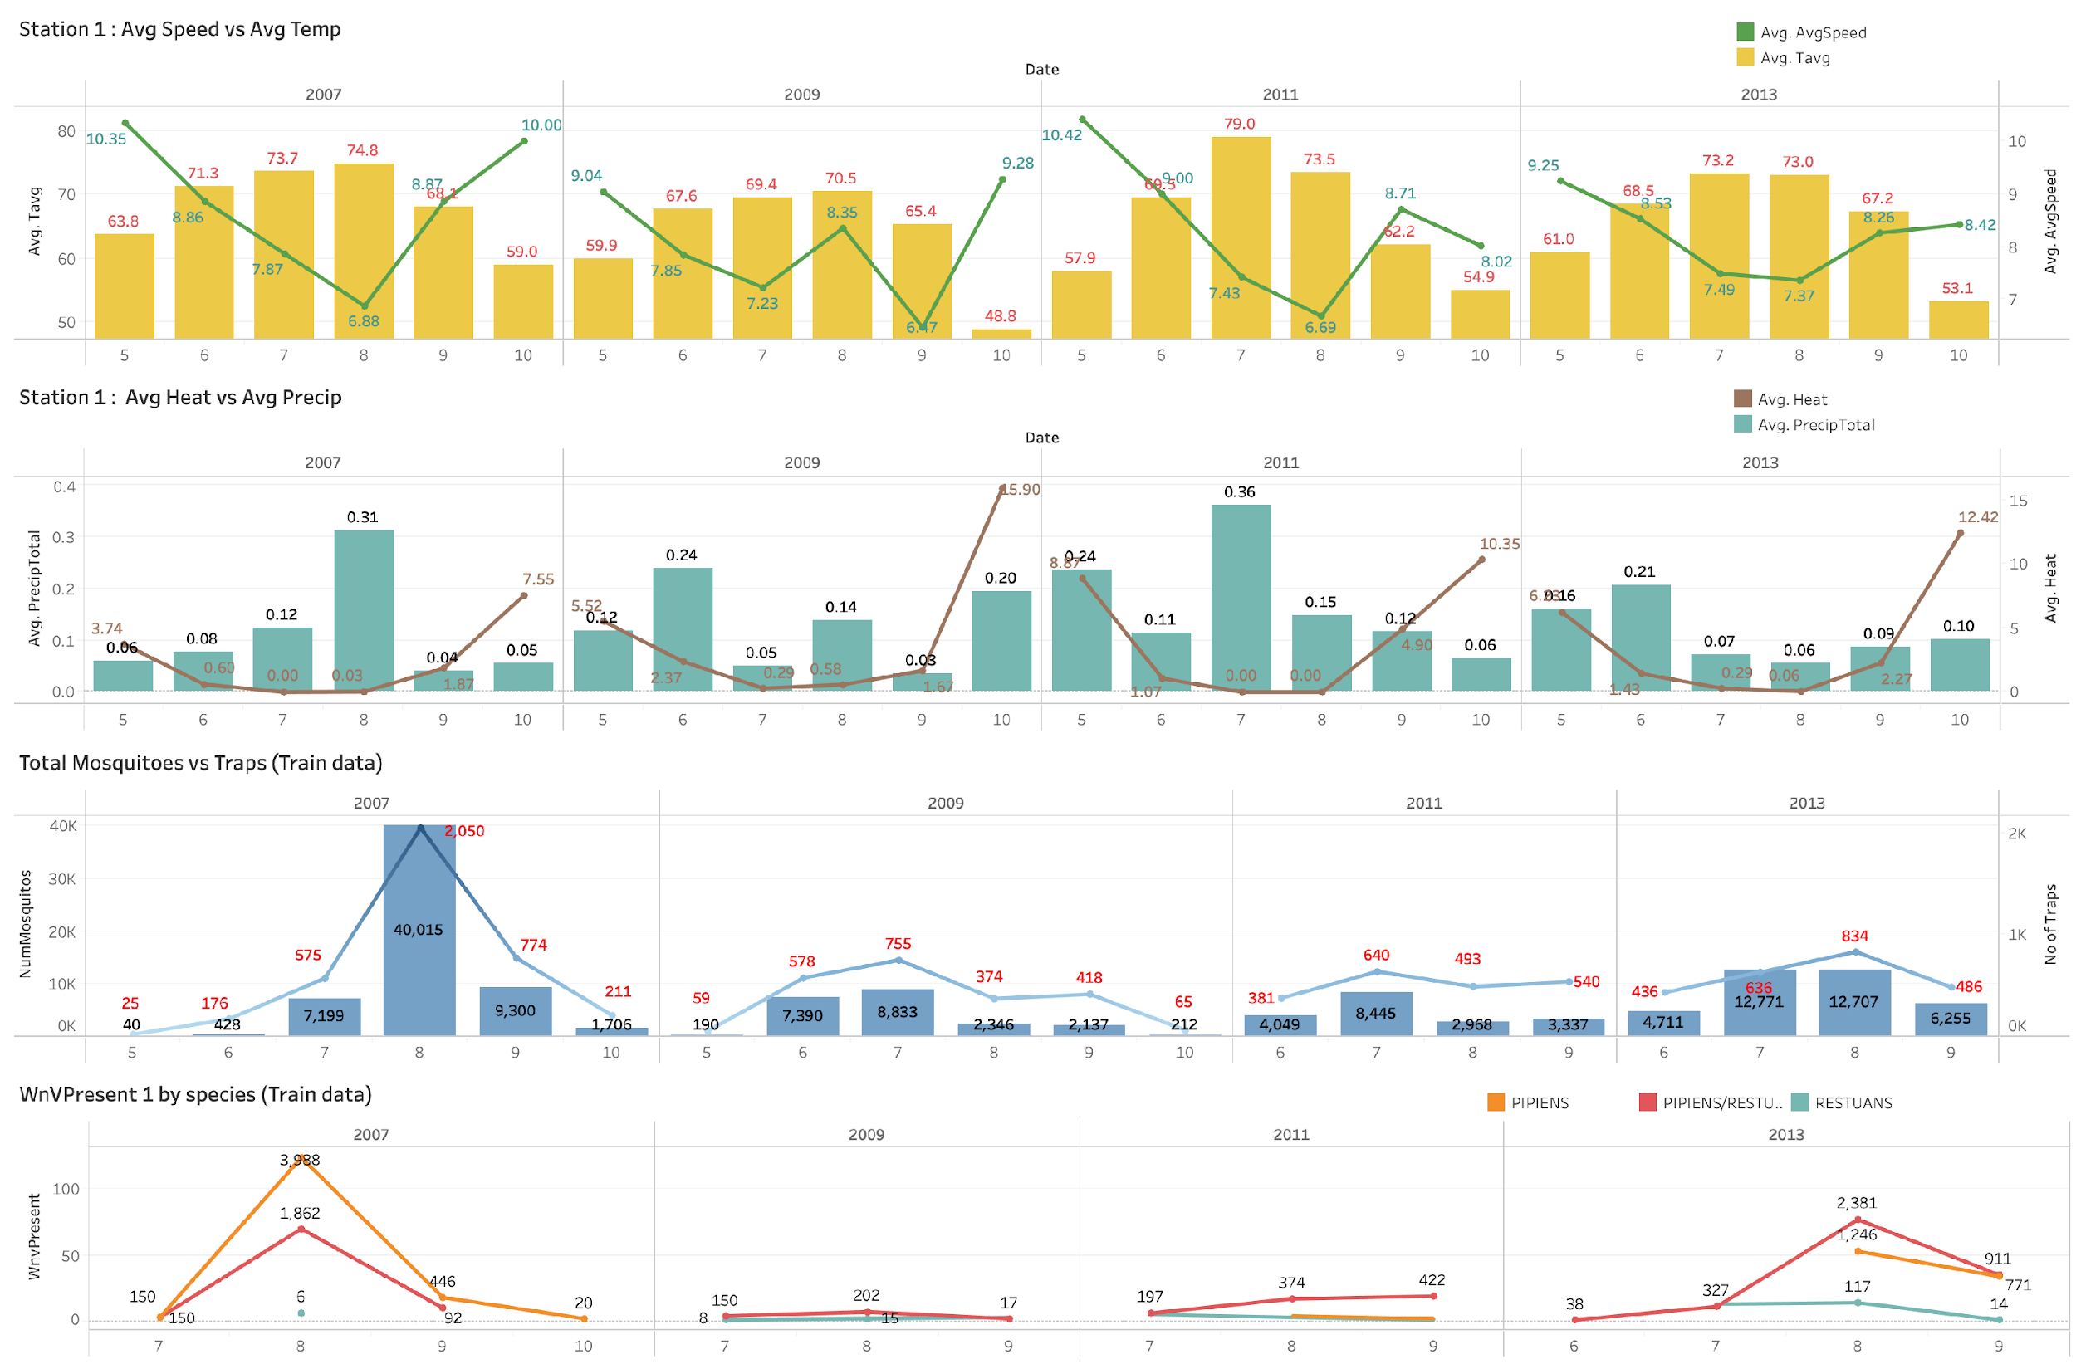
EDA – Weather vs Train Data
1) There is a negative correlation between the wind speed and Avg Temp, the
2) Mosquitoes seem to breed faster in conditions where wind speed is low and both precipitation level + average temp are high.
3) The traps were deployed seasonally and the numbers tend to build up between Jul to Sep for the observed period.
There is a negative correlation between the wind speed and Avg Temp, the precipitation level and the no. of mosquitoes.
Mosquitoes seem to breed faster in conditions where wind speed is low and both precipitation level + average temp are high.
The traps were deployed seasonally and the numbers tend to build up between Jul to Sep for the observed period.

Slide 15
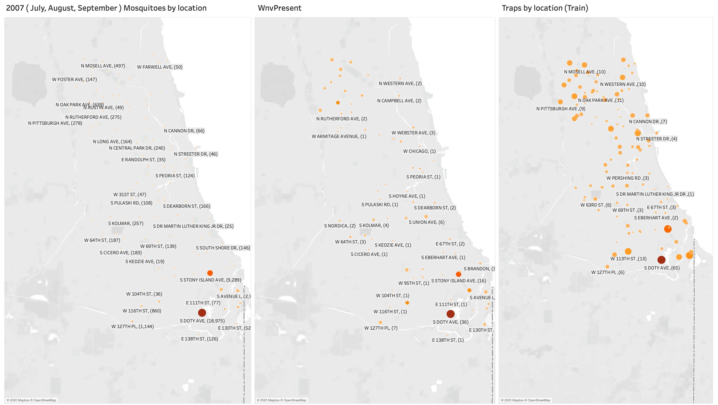
EDA – No of Mosquitoes vs WnV Present vs Traps by Location (Train Data)
The mosquitoes clusters had migrated northwards
The presence of the WnV is also correlated to the mosquitoes cluster.

Slide 16
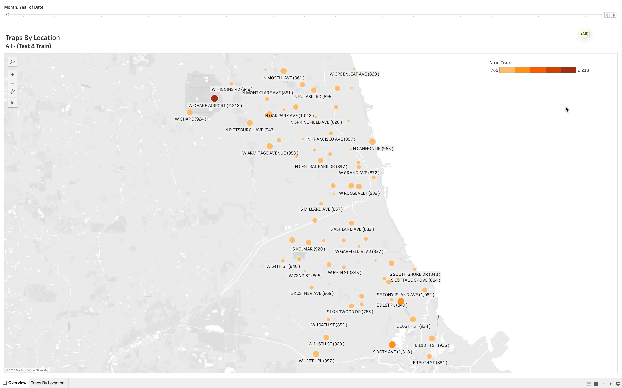
EDA – Strategic Trap Placements (Train & Test Data)
We see that the traps are strategically placed over the years.

Slide 17
Modeling + Evaluation
2

Slide 18
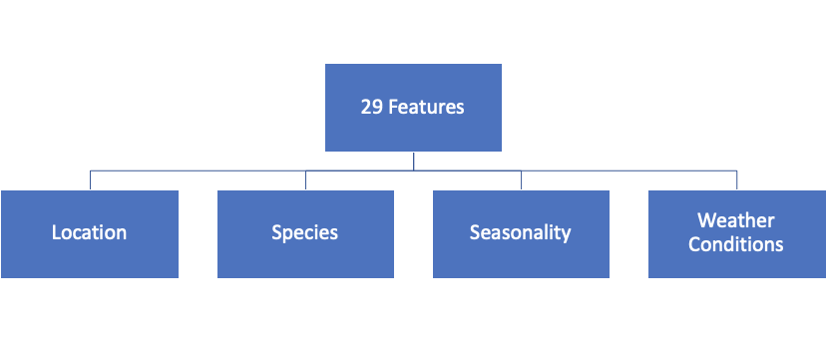
Features selected for modeling
cool_rolling_14 | heavy_rain_last_14_days_count
preciptotal_rolling_14 | light_rain_last_14_days_count
stnpressure_rolling_14 | tmax_rolling_14
sealevel_rolling_14 | tmin_rolling_14
resultspeed_rolling_14 | tavg_rolling_14
resultdir_rolling_14 | depart_rolling_14
avgspeed_rolling_14 | dewpoint_rolling_14
day_length_rolling_14 | wetbulb_rolling_14
heat_rolling_14
latitude
longitude
spray_cluster
dist_from_ohare
dist_from_doty
culex_pipiens
culex_pipiens/restuans
culex_restuans
day
week
month
year

Slide 19
Target variable: WNV presence

Slide 20
Baseline score: ROC AUC 0.5
Model
Baseline score: 0.5

Slide 21
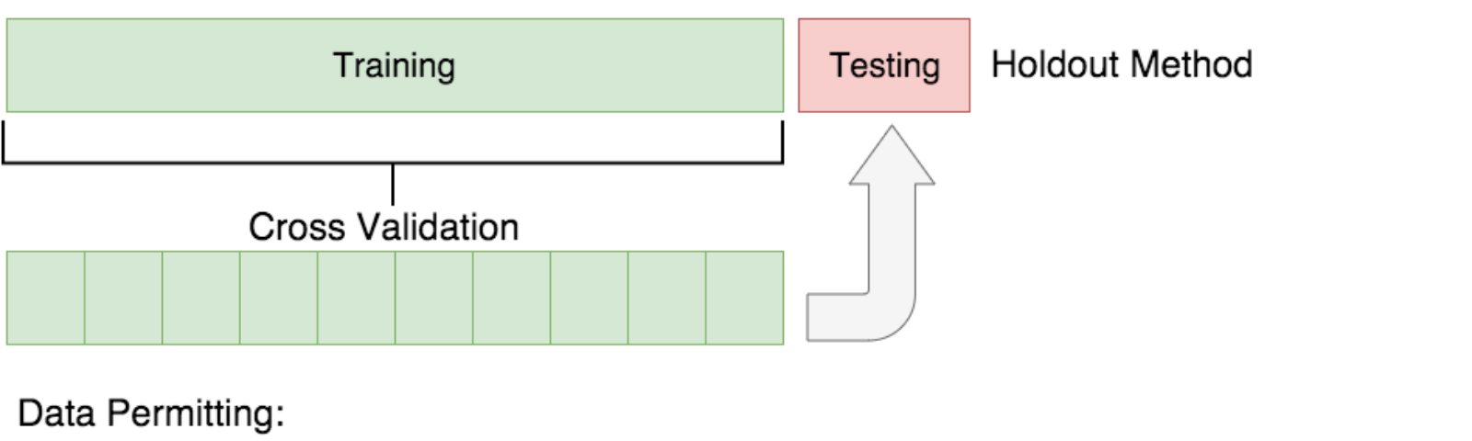
Train-test-split and GridSearchCV
Training set (80%)
Validation set (20%)
GridSearchCV with 5-fold cross validation
Scoring: ROC AUC

Slide 22
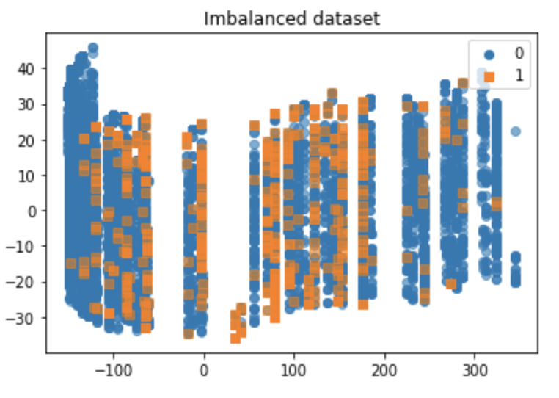
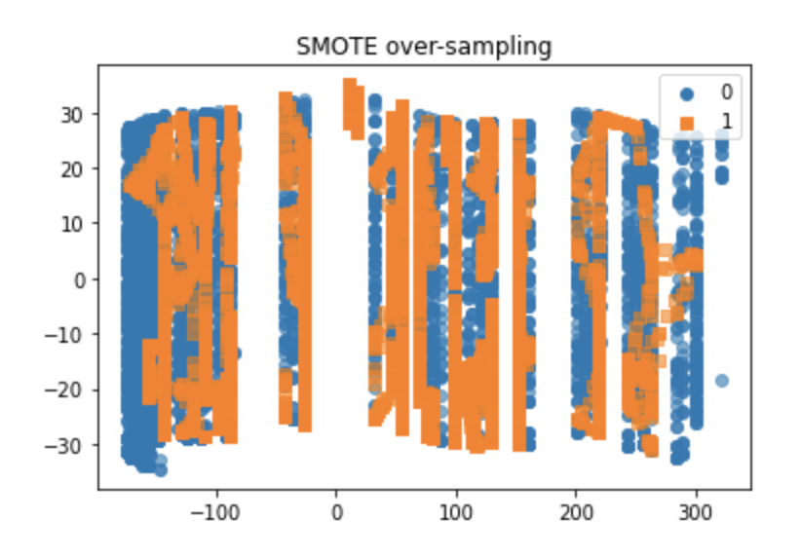
Handling Imbalanced Classes: SMOTE
SMOTE was used on:
Logistic Regression
SGD
Bagging
AdaBoost
Gradient Boosting

Slide 23
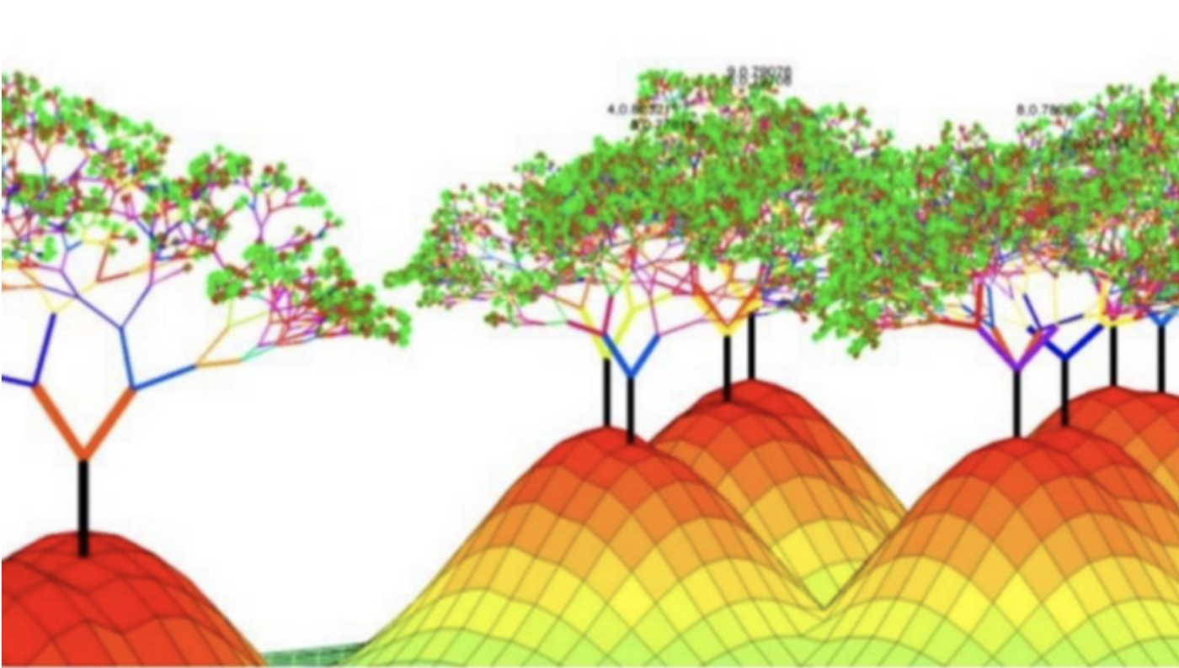
Handling Imbalanced Classes: ‘weighting’ hyperparameter
Random Forest ‘class_weight’: Balanced
XGBoost ‘scale_pos_weight’:
Ratio of the no. of negative class to the positive class

Slide 24
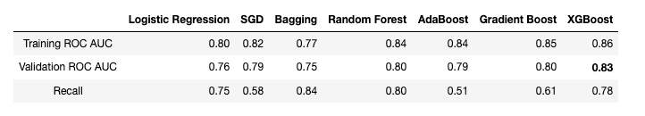
Model Evaluation
XGBoost was selected as it achieved the best ROC AUC score on the validation set.

Slide 25
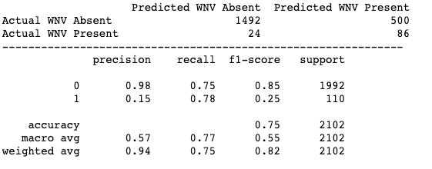
XGBoost Classifier
Best parameters:
colsample_bytree: 0.5
eval_metric: 'auc'
gamma: 0.1
learning_rate: 0.1
max_depth: 3
n_estimators': 100
objective: 'binary:logistic'
reg_alpha: 100
reg_lambda: 100
scale_pos_weight: 18.06
subsample: 0.5
Best CV ROC AUC score: 0.84
Training ROC AUC score: 0.86
Validation ROC AUC score: 0.83

Slide 26
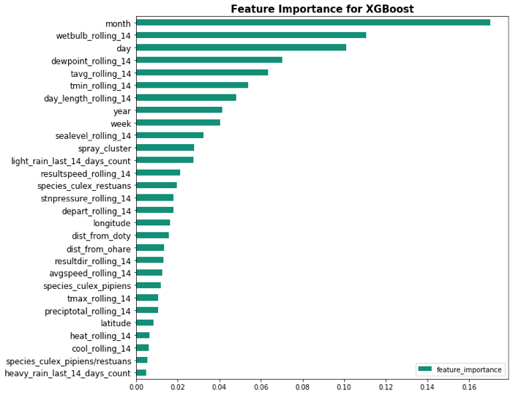
Feature Importance
1) There is a negative correlation between the wind speed and Avg Temp, the
2) Mosquitoes seem to breed faster in conditions where wind speed is low and both precipitation level + average temp are high.
3) The traps were deployed seasonally and the numbers tend to build up between Jul to Sep for the observed period.
Seasonality and weather conditions play key roles in the prevalence of WNV

Slide 27
0.76
Kaggle
Private and public score

Slide 28
Cost Benefit Analysis
3

Slide 29
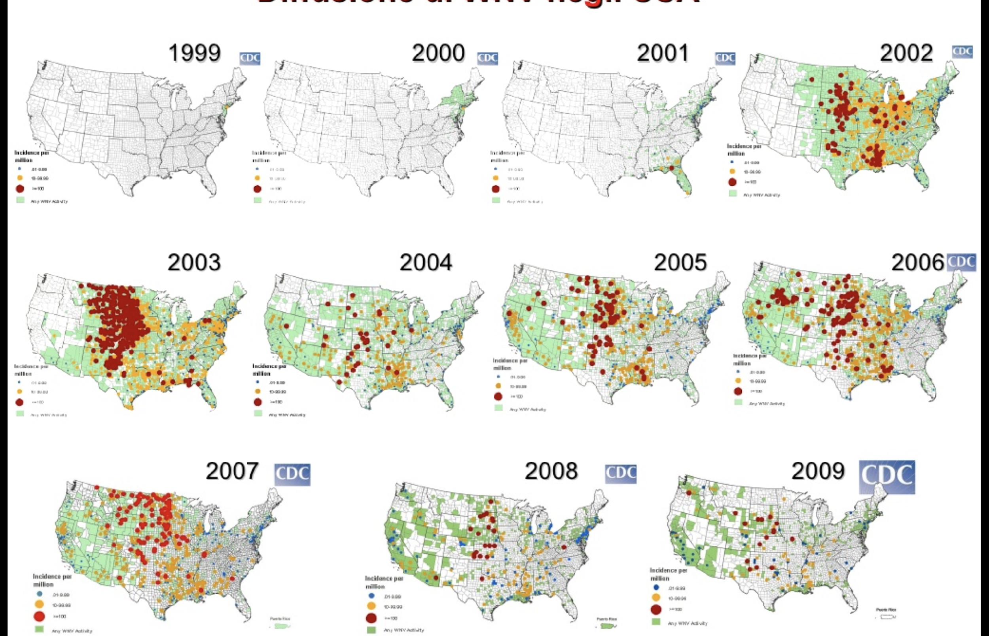
West Nile Virus in United States since 1999

Slide 30
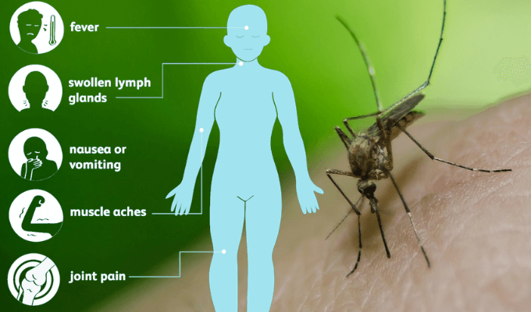
Case Study in Sacramento County in 2005
A research evaluated that decrease in 15 WNV disease cases is needed to mitigate the cost of emergency aerial spray response.

Slide 31
Types of Patients
West Nile Virus (WNV)
West Nile neuroinvasive disease (WNND): severe, affecting the central nervous system symptom
West Nile fever (WNF):
disease can be mild, causing flu-like side effects

Slide 32
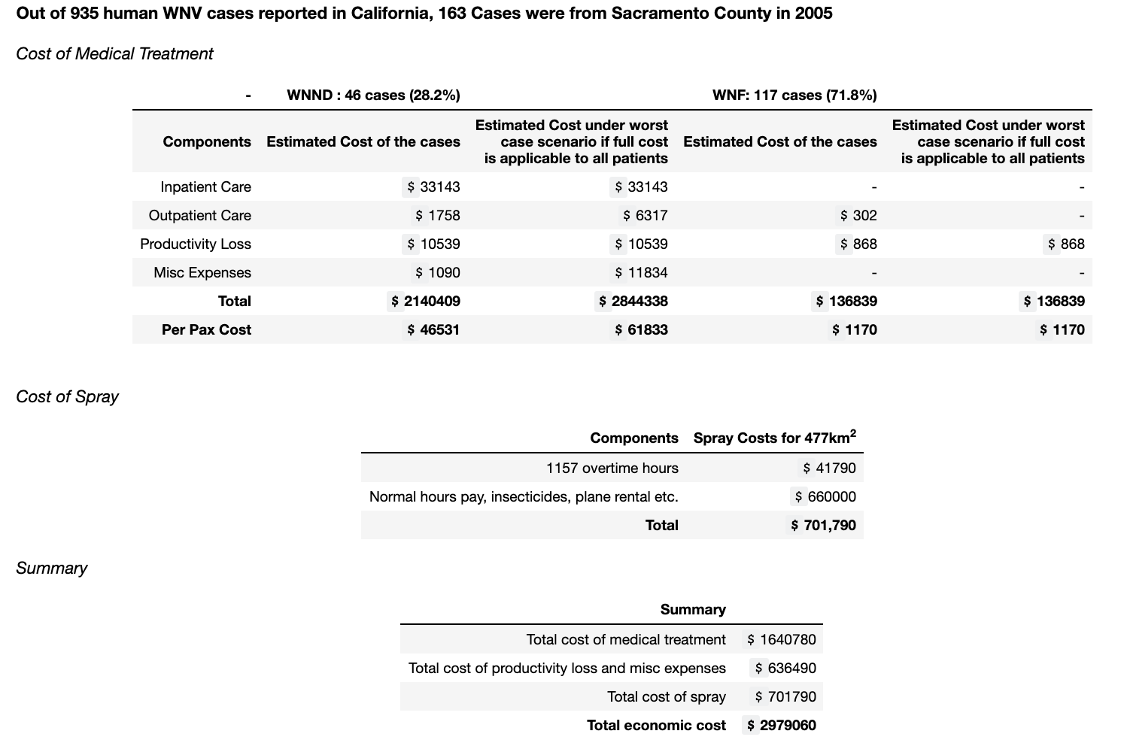

Slide 33
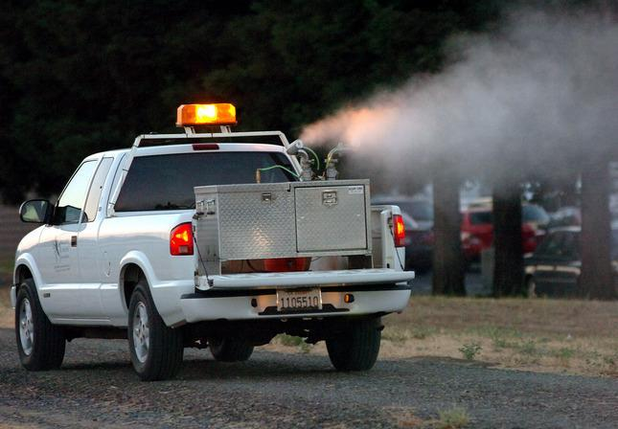
Effectiveness of Spray
In another research, zero cases were reported in spray area and 18 cases outside.
Only 15 WNND cases prevention is needed for the benefits of the spray response to exceed the expense of the virus for Sacramento County in 2005.

Slide 34
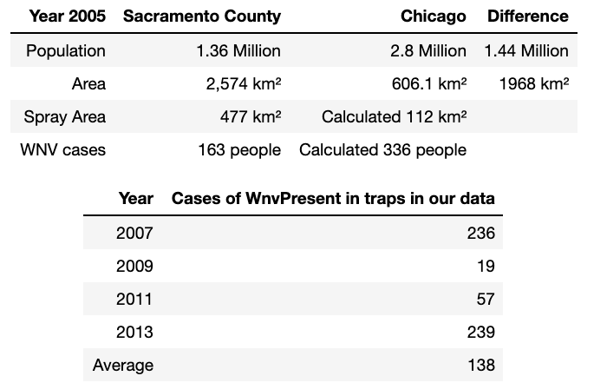
Cross Referencing
Considering the land size and population in 2005, we assume similar spray area is needed to control Chicago mosquito population to reduce WNV and similar number of people were infected.
Hence, let's consider cost benefit analysis for 336 infected people and spray area of 112 km².

Slide 35
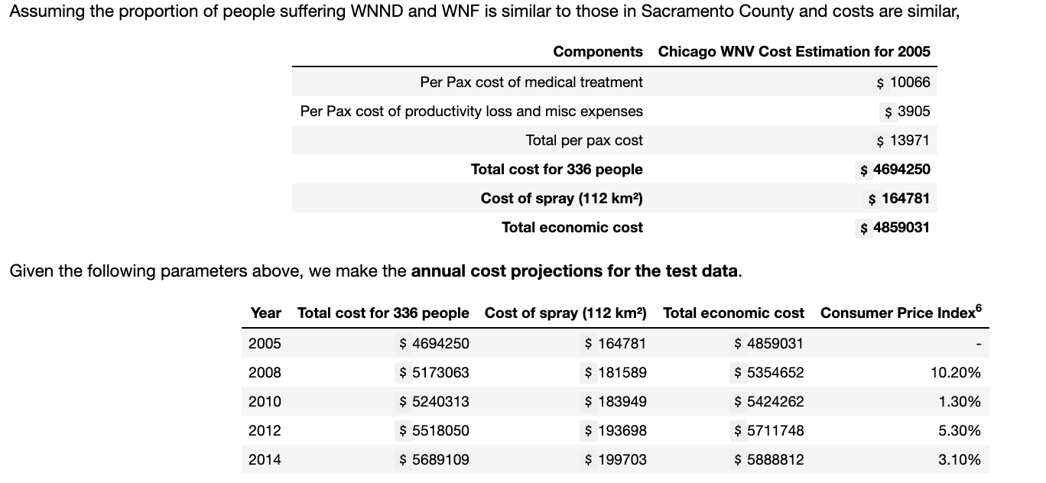
Cost Benefit Analysis for Chicago from 2005 to 2014
Pain, mental health costs, and ecological risks associated with the emergency spray is not included.

Slide 36
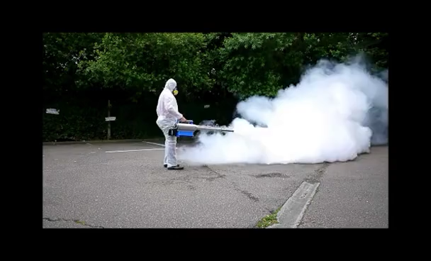
Best Preventive Method
Spraying at areas with more than 12 WNV cases overweighs the cost of the spray, suggesting that spraying at those areas is the most cost effective solution.
In addition, reduction in cost of 1 WNV case overweighs the spraying of of 10km² area.

Slide 37
Conclusion and Recommendations
4

Slide 38
Conclusion
XGBoost model attained a ROC AUC of 0.83 on the validation set, outperforming the baseline score of 0.5.
Model's feature importance: seasonality 'month’ ,'week' and 'day', 14-day rolling weather conditions like wetbulb, dewpoint and temperature.
Spraying at areas with more than 12 WNV cases overweighs the cost of the spray.
In addition, reduction in cost of 1 WNV case overweighs the spraying of of 10km² area.

Slide 39
Target Specific Breed
Culex Pipiens
Culex Restuans
Culex Territans
Culex Tarsalis
Culex Salinarius
Culex Erraticus

Slide 40

Vaccination for West Nile Virus
Research analysis suggests that universal vaccination against the West Nile Virus would unlikely result in societal monetary savings unless disease incidence increases drastically.
Hence, spraying is still the best method

Slide 41
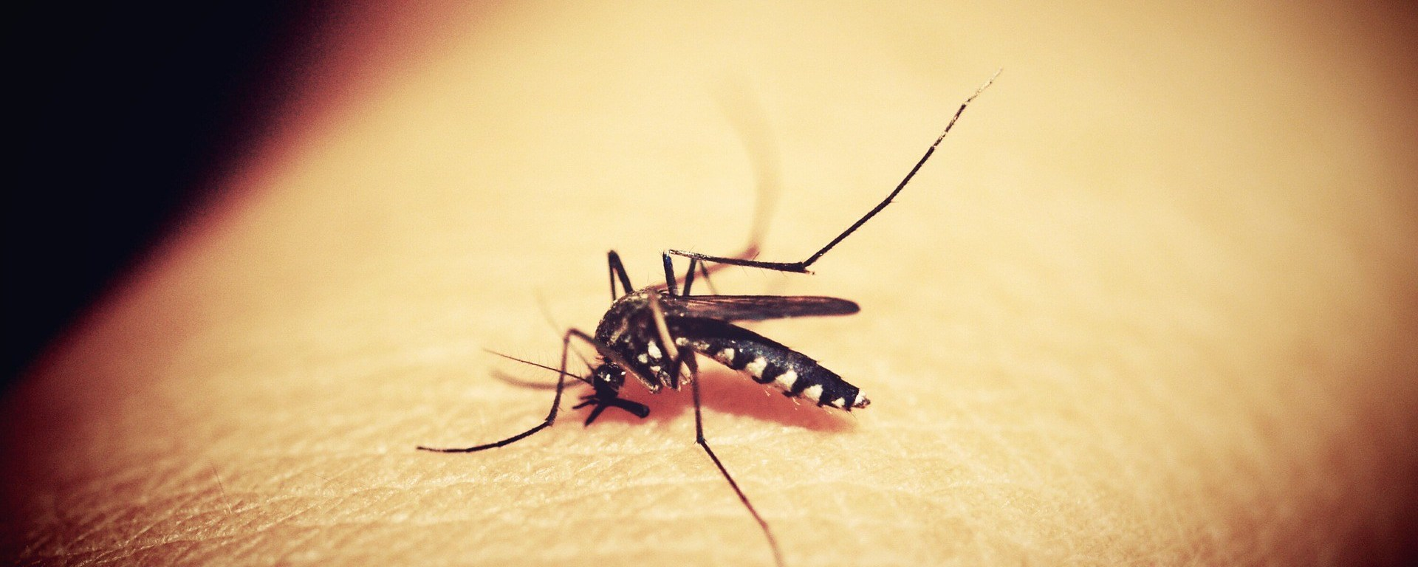
If you think you are too small to be effective, you have never been in the dark with a mosquito

Slide 42
THANKS!
Any questions?

Slide 43
Appendix

Slide 44
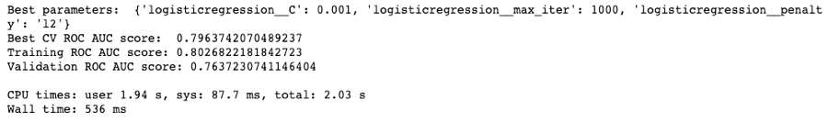
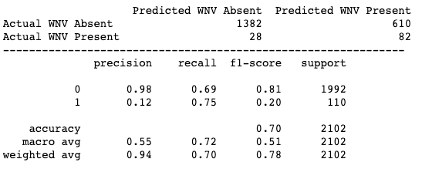
Logistic Regression
Notes:
Logistic regression is one of the most commonly used methods for binary classification problems.
We will apply logistic regression here to predict the probability of WNV presence.

Slide 45
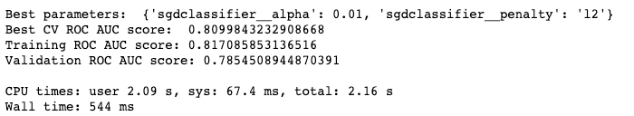
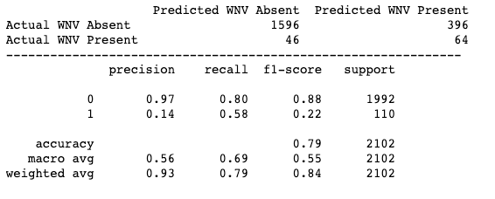
Stochastic Gradient Descent
Notes:
SGD Classifier implements regularised linear models with Stochastic Gradient Descent. We will instantiate the SGDClassifier using loss='log' to implement the logistic regression and compare its performance to the previous model.

Slide 46
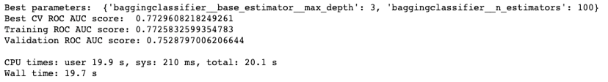
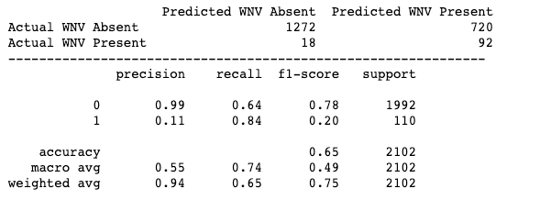
Bagging Classifier
Notes:
As decision trees tend to overfit on the training data, we will use bagged decision trees instead. Bagging is an ensemble method that conducts random resampling with replacement to create multiple models and aggregates the predictions.

Slide 47
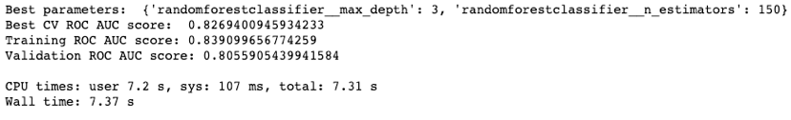
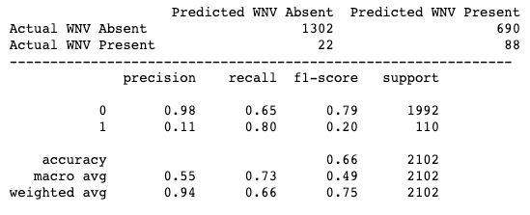
Random Forest Classifier
Notes:
With bagged decision trees, we generate many trees on very similar data ie if a certain seasonality feature is a strong predictor of WNV, each bagged tree node will be simliar. These trees will thus be very strongly corelated with one another. Random forest will be useful in 'de-correlating' our trees. This is done by selecting a random subset of features at each node.

Slide 48
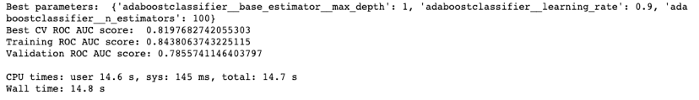
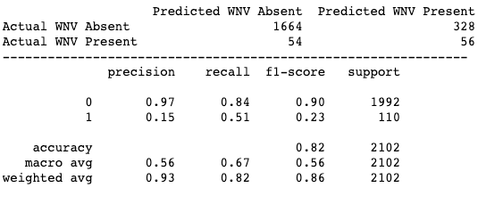
AdaBoost Classifier
Notes:
AdaBoost is a boosting ensemble method that fits a sequence of weak learners on modified versions of the data. AdaBoost works by putting more weight on misclassifications and less on those already handled well. This allows it to convert a set of weak classifiers into a strong one.

Slide 49


Gradient Boosting Classifier
Notes:
While the AdaBoost model identifies the shortcomings by using high weight data points, gradient boosting performs the same by using gradients in the loss function.

Slide 50
Types Of Costs
Inpatient Care: average charge of hospital patient discharge database from California’s Office of Statewide Health Planning and Development (OSHPD)
Outpatient Care: using the 2002 outpatient costs determined by Zohrabian et al. and updated to 2005 using data from the Consumer Price Index (CPI) for the western United States, obtained from the US Department of Labor, Bureau of Labor Statistics Productivity Loss.
Productivity loss: assumed 60 days. For caretakers, productivity loss was assumed to be 25 days. Using the mean annual earnings for full-time workers in 2005, the cost for a day of work missed by an average Sacramento adult citizen is calculated. The cost attributed to productivity loss is an estimate; true monetary value for pain and distress and the productivity loss associated with chronic WNND are uncertain.
Miscellaneous: nursing home, transportation, home-health aides, and childcare costs accrued during recovery. 3.6% of the WNND cases spent 96 days in nursing homes. The transportation cost to all WNND cases, and applied costs for home-help aides to 14.4% of the WNND cases.

